Slide 1
Class Project: Spike Sorting
Dr. Cios : kcios@vcu.edu
Hun Ki Lim: limhk@vcu.edu

Slide 2
Outlines
Domain Knowledge
Data
Methodologies
Analysis tools
  WEKA
  MATLAB

Slide 3
Domain Knowledge
Definition
  Detection and classification(clustering) process of spikes from extracellular recordings of neurons using electrodes
Goal
  To know if there are responsive neurons
Result
  Some neurons were responsive
  Neurons in a certain area responds to certain input(s)

Slide 4
Data
Data format
  Database, Text, Matlab, Excel, etc.
Data conversion
Text Editor
.txt
.arff
.mat
WEKA
Data
Matlab
.txt
.csv
Excel
.arff

Slide 5
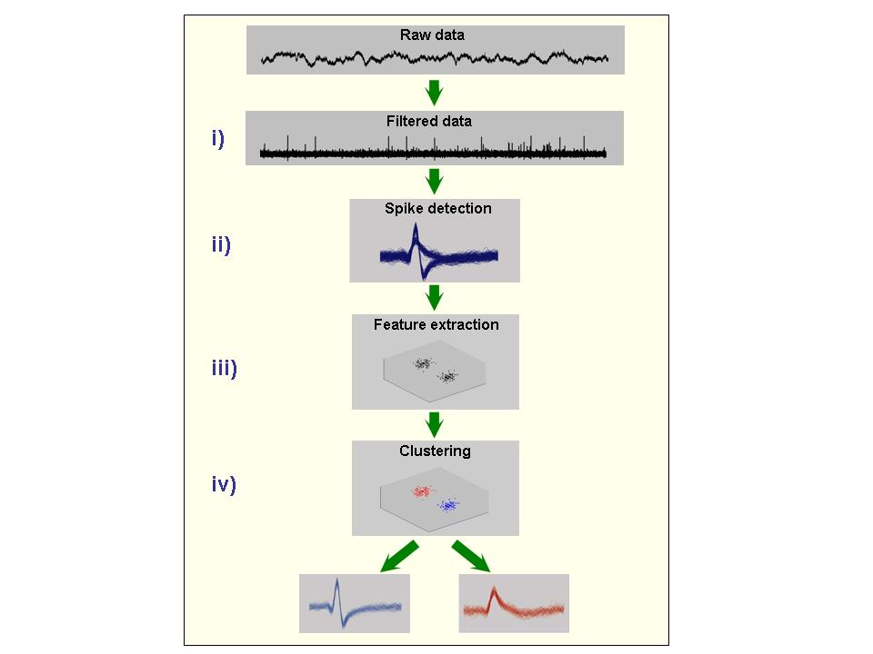
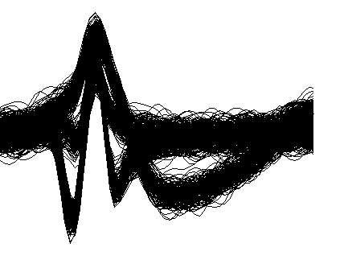
Methods
Windowing

Slide 6
Method
Semi-automatic procedure
  Human interruption
Full-automatic procedure
  No human interruption

Slide 7
Tools
Most programming languages
  Java, C, C++, C#, etc.
  Matlab, R, etc.
Data mining tools
  WEKA
  Rapid Miner

Slide 8
WEKA
Introduction
  A collection of open source ML algorithms
    pre-processing
    classifiers
    clustering
    association rule
  Created by researchers at the University of Waikato in New Zealand
  Java based
  Routines are implemented as classes and logically arranged in packages
  Comes with an extensive GUI interface
Notes:
Talk about
* hacking weka
* discretization
* cross validations

Slide 9
WEKA
Installation
  Download software from http://www.cs.waikato.ac.nz/ml/weka/
    If you are interested in modifying/extending weka there is a developer version that includes the source code

Slide 10
Data Format
Uses flat text files to describe the data
Can work with a wide variety of data files including its own “.arff” format and C4.5 file formats
Data can be imported from a file in various formats:
  ARFF, CSV, C4.5, binary
Data can also be read from a URL or from an SQL database (using JDBC)

Slide 11
ARRF file format
@relation heart-disease-simplified
@attribute age numeric
@attribute sex { female, male}
@attribute chest_pain_type { typ_angina, asympt, non_anginal, atyp_angina}
@attribute cholesterol numeric
@attribute exercise_induced_angina { no, yes}
@attribute class { present, not_present}
@data
63,male,typ_angina,233,no,not_present
67,male,asympt,286,yes,present
67,male,asympt,229,yes,present
38,female,non_anginal,?,no,not_present
...
numeric attribute
nominal attribute
A more thorough description is available here http://www.cs.waikato.ac.nz/~ml/weka/arff.html

Slide 12
Explorer
Preprocessing
  Pre-processing tools in WEKA are called “filters”
  WEKA contains filters for:
    Discretization, normalization, resampling, attribute selection, transforming, combining attributes, etc

Slide 13
Explorer
Classifier
  Classifiers in WEKA are models for predicting nominal or numeric quantities
  Implemented learning schemes include:
    Decision trees and lists, instance-based classifiers, support vector machines, multi-layer perceptrons, logistic regression, Bayes’ nets, …
  “Meta”-classifiers include:
    Bagging, boosting, stacking, error-correcting output codes, locally weighted learning, …
Cluster
  Implemented learning schemes include:
    EM, SimpleKMeans, etc.

Slide 14
Matlab
Development of new techniques
Applying new techniques
Visualization
  3D plot

Slide 15
Practices
Data conversion
Classification with WEKA
Clustering with WEKA
Clustering with MATLAB

Slide 16
Suggestions
Progress report presentation
  Describe in about 5 slides (5 min of presentation plus 3 min for discussion)
    Preprocessing of the data you have made
  Clustering with WEKA and analysis and conclusions
Final project presentation
  Max 20-25 slides (20 min presentation plus 5 for discussion)
  Show results of several techniques
  Show evaluation of your results
  Key findings
  Provide all working code you have wrote for the project such as for visualization, etc.

